Slide 1
COURSE REGISTRATION SYSTEM
YUVAPRIYA V, 43111056

Slide 2
AGENDA
Abstract
Existing system
Proposed system
Advantages
Disadvantages
Hardware requirements
Software requirements
Modules
Module description
Sample output(screenshot)
Conclusion

Slide 3
ABSTRACT
The Course Registration System is a web-based platform designed to simplify and automate the process of course enrollment in educational institutions. It allows students to log in securely, view available courses, and register for their preferred subjects with ease. The admin can manage course details and view the list of students registered for each course. This system eliminates manual paperwork, reduces human errors, and ensures smooth and efficient registration management.

Slide 4
EXISTING SYSTEM
​In the existing manual registration process, students are required to fill out paper forms or register offline, which is time-consuming and prone to errors. The administration has to manually verify and record each registration, leading to delays, data redundancy, and difficulties in managing large student records. There is also limited transparency for students to track available courses or confirm their enrollment status.

Slide 5
PROPOSED SYSTEM
The proposed Course Registration System automates the entire registration process. Students can log in using valid credentials, view all available courses, and register for the courses they want. The system updates the database instantly after registration. The admin can log in to monitor registered students and manage course details efficiently. This approach saves time, reduces administrative effort, and provides a seamless experience for both students and administrators.

Slide 6
ADVANTAGES
​Eliminates manual paperwork and reduces processing time.
Provides real-time updates of available and registered courses.
Easy access and management through a user-friendly web interface.
Ensures data accuracy and security.
Simplifies tracking and reporting for administrators.

Slide 7
DISADVANTAGE
The system requires a stable internet connection to function properly.
If the server crashes, temporary loss of access can occur for students and admins.
Technical knowledge is required for maintenance and troubleshooting.
The system may not integate easily with legacy institutional software with customization.

Slide 8
HARDWARE REQUIREMENTS
Processor: Intel i3 or higher
RAM: Minimum 4 GB
Hard Disk: 250 GB or more
System Type: 64-bit Operating System

Slide 9
SOFTWARE REQUIREMENTS
Operating System: Windows 10 or later
Frontend: ReactJS
Backend: Spring Boot (Java)
Database: MySQL
Build Tool: Maven
IDE: IntelliJ IDEA / VS Code / Eclipse
Browser: Chrome or Edge

Slide 10
MODULES
Student Module
Admin Module
Course Module
Registration Module

Slide 11
MODULE DESCRIPTION
1. Student Module
Handles student login and registration. Students can view available courses and register for selected ones.
2. Admin Module
Allows the admin to log in securely and view a list of registered students. The admin can also manage course details.

Slide 12
MODULE DESCRIPTION
3. Course Module
Displays all available courses. Admins can add, update, or delete courses.
4. Registration Module
Maintains records of course enrollments by linking students to their selected courses

Slide 13
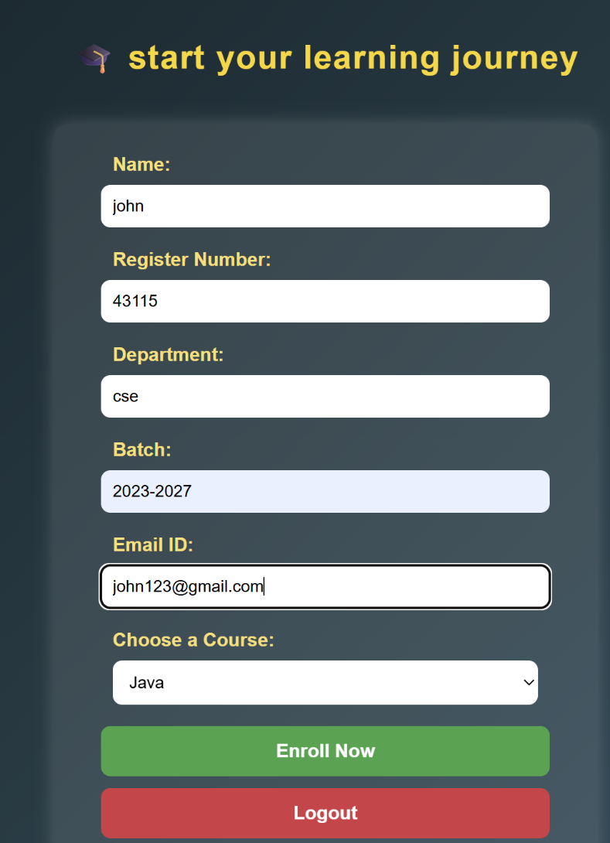
OUTPUT

Slide 14
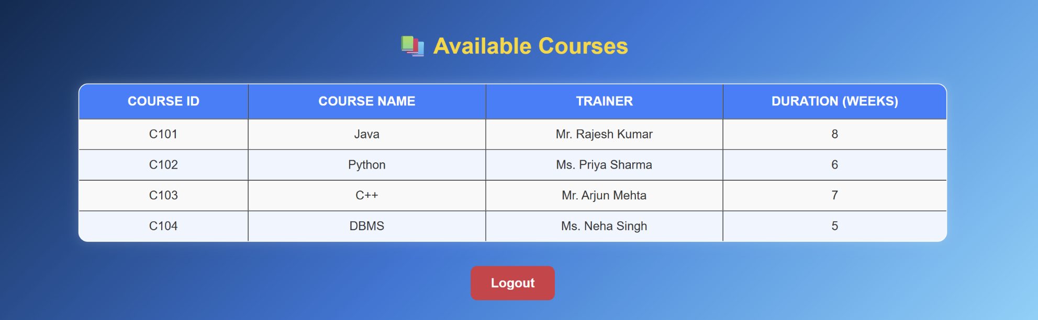

Slide 15
CONCLUSION
The Course Registration System provides an efficient digital solution to manage student course registrations. By automating manual processes, it enhances accuracy, saves time, and reduces administrative workload. The system ensures transparency for students and better management for administrators, making it a valuable addition to any educational institution.

Slide 16
THANK YOU
We thank God, Our Department, Guide, Panel Members, Supportive Professors and all Technical and non Technical staff who helped us in our Project.

